Slide 1
Bankruptcy Machine Learning Model
Kavish, Chang and Damian

Slide 2
Introduction
The aim of this project is to use machine learning to predict whether an individual will become bankrupt based on their financial history.
Uses of the model: can be used as a tool for credit loan assessments, providing efficient and accurate way to evaluate the risk of an individual becoming bankrupt
Data Processing
Splitting Data
Testing Model
Building ML Model
Training model
Making Predictions
User Interface

Slide 3
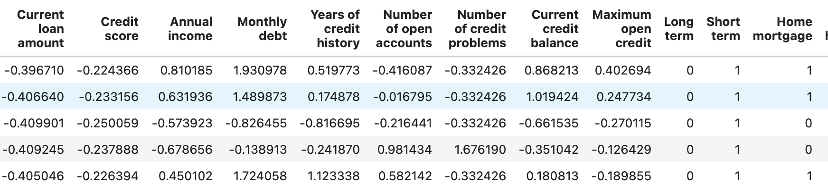
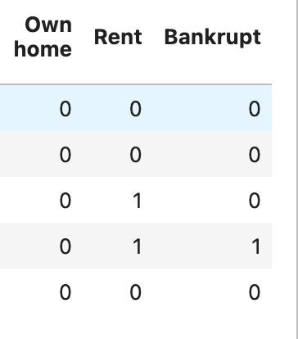
Background
Dataset: https://www.kaggle.com/datasets/zaurbegiev/my-dataset
Variables in the dataset: Loan ID, Customer ID, Current loan amount, Term, Credit Score, Annual income, Current years in job, Home Ownership, Purpose, Monthly dept

Slide 4
Data Cleaning
Unwanted values were dropped based on research, this included null values within the dataset.
The following data was dropped during the data cleaning process: Loan ID, Customer ID, Years in current job, Loan status, Tax liens and purpose.
Data was stored in an SQL database.
Dataset was standardized to preform machine learning

Slide 5
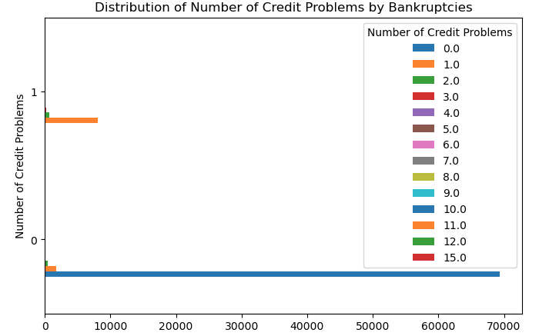
Data Analysis

Slide 6
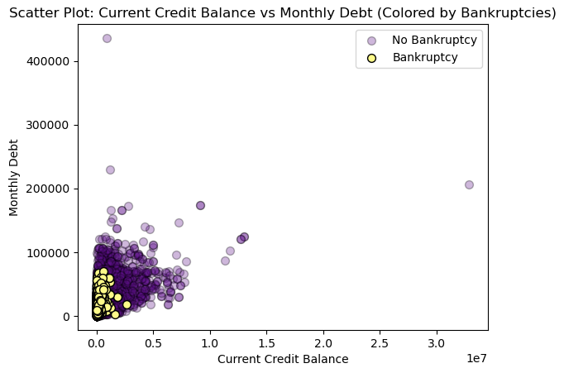
Data Analysis

Slide 7
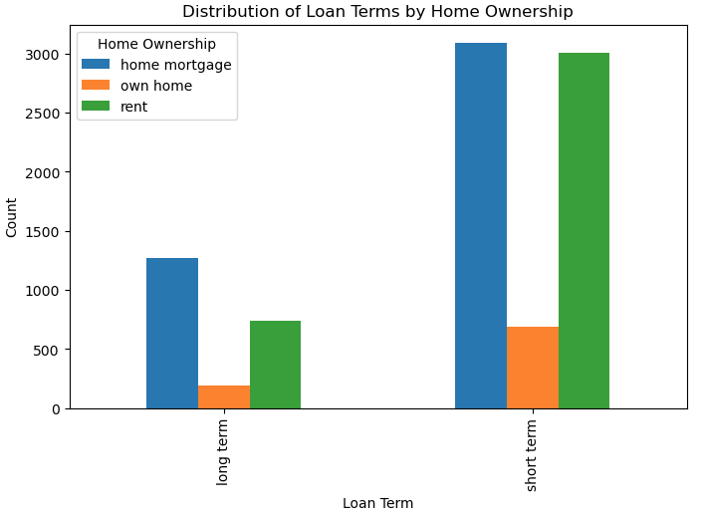
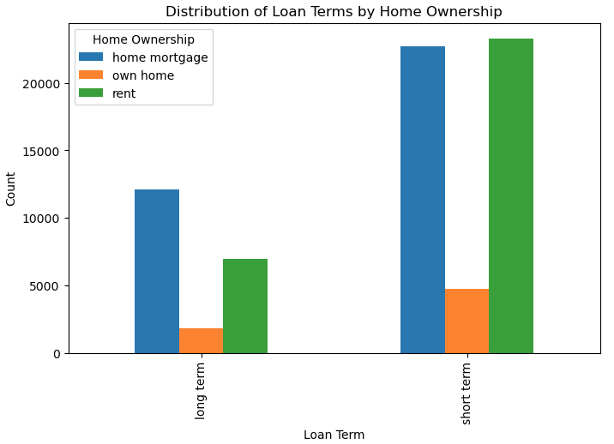
Data Analysis
Bankrupt
Not Bankrupt

Slide 8
Machine Learning Models
Neural Networks
Random Forest
Ensemble

Slide 9
Comparison
Model | Accuracy Score
Random Forest | 0.9794
Neural Networks | 0.89
Ensemble | 0.99* *Heavily imbalanced model

Slide 10
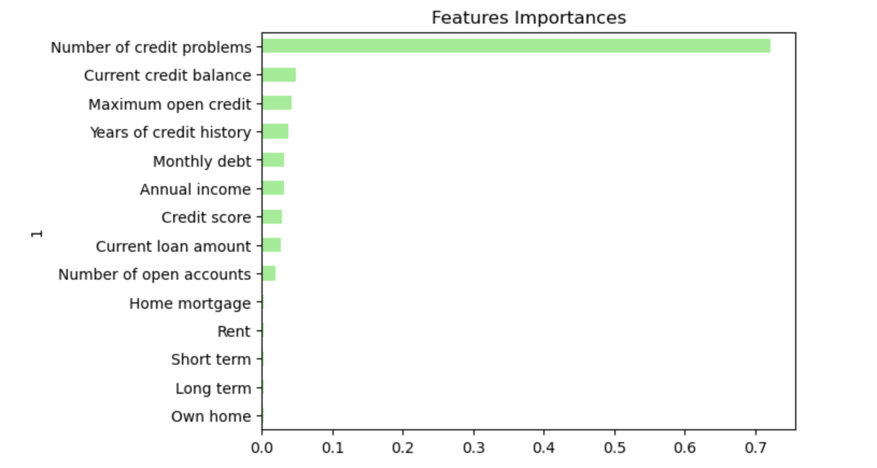
Random Forest (Chosen Model)
Random Forest is an ensemble learning method commonly used for classification, regression, and other machine learning tasks. It belongs to the family of tree-based models and is known for its high accuracy, robustness, and versatility.
Optimization: The model was optimized by altering the number of trees, tree depth and feature importance.

Slide 11
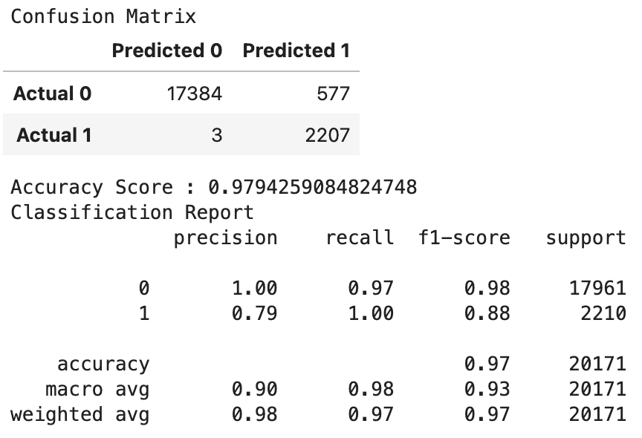
Random Forest - Results
Model Run | Accuracy Score
Initial Model | 0.9794
Optimization 1 – estimators | 0.9792
Optimization 2 – class weight adjustment | 0.9794

Slide 12
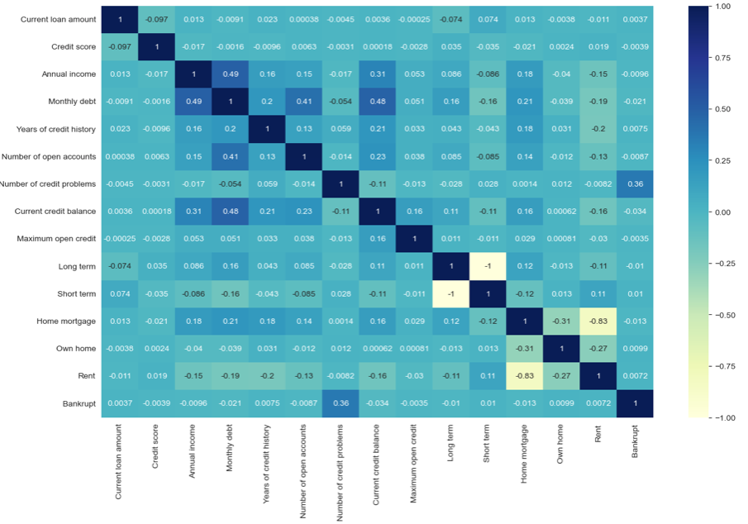
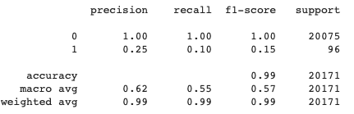
Ensemble
Ensemble combines predictions of model to improve the outcome of the prediction

Slide 13
Neural Networks
They are composed of interconnected nodes, or artificial neurons, organized into layers. Neural networks are capable of learning complex relationships and patterns in data

Slide 14

User interface
JavaScript
HTML
Flask
Inputs

Slide 15
Limitations
The size of the data set.
The origin of the dataset – no information regarding the source of the data.
Limitations of the model used to make predictions.

Slide 16
Conclusion
Machine learning is a powerful tool, which can be used to automate manual tasks.
Overall number of credit problems, current credit card balance and maximum open credit was the main factors (according to the Random Forest model) which influenced the outcomes during predictions.

Slide 17
Future Work
Using a more balanced the dataset, explore over sampling and/or expand datasets.
Further optimizations to do the model and exploration of additional models.

